Slide 1
Starwriter Medical Data – the “ Next Generation” of data sources
Starwriter Medical Data is the only data source that streams data in real-time to your company/teams.
Consequently, Starwriter is emerging in our field as the Pinnacle of structured, clinical/medical data sources.
The Starwriter Medical Data’s Patented process is what makes us unique and
truly the “ Next Generation” of data sources.
Starwriter’s collection arm for data, is it’s EMR system – DOX EMR,
which is a 2015/stage 3 certified EMR system.
Our data is EHR data, however, the unique key is that we are Data Base Driven.
All selections that are made in the chart note creation process, by healthcare providers, is moved directly into our data base-
So, Starwriter provides teams at pharma, complete control of data details and content, which ensures both highest quality and accuracy of our data for your teams’ DCTs, RWE, HEOR, VEO, PRO and all of your company’s analytics and data needs.
Once the healthcare provider completes their chart note- as mentioned above, Starwriter’s structured data is immediately available to pharma teams for evaluation.

Slide 2
Starwriter’s patented process is in sharp contrast to all other EMR systems, in which the chart notes are created by healthcare providers either using pre-built ” customized” templates or even typing individual chart notes.
Both of which introduce large numbers of unaccounted for variables and contribute to “uncertainty of data”.
Additionally, both of these 2 methods used by other EMR systems only create Flat text (Word documents, etc), which then must by “ scraped” by some method ( typically key word or billing code searches, etc) and then details must, somehow, be entered into a data base.
The data that is extracted using these methods from other EMR systems is unstructured data and typically lacks key details that are essential for teams at pharma and medical device companies to perform their analytics with accuracy and precision for RWE, HEOR, VEO, PRO, etc.
Frequently, analytics teams, may not even be aware of or fully appreciate the effects this “uncertainty of data”, issues with claims based data,etc is having on their analyses.
We discuss these challenges in detail in videos we have created on our website.
http://www.drbartssolutions.com/data-benefits-speed-specificity-pg-2.html

Slide 3
Data base driven/ Structured data base - yields greatest detail and accuracy of data
Most everyone in our field is aware of EDC systems (Electronic Data Capture).
These are typically separate apps, that some one has to use to manually enter details from EHR chart notes, as they interpret them, into the EDC.
With Starwriter - the EMR system is the EDC.
This allows us to completely control all data points the provider is selecting to add detail to their chart notes-
which provides critical data details needed by pharma for optimal analytics.
Control of data entered by healthcare providers guarantees collection of critical data points that optimize accurate and detailed analytics by pharma analytics teams.

Slide 4
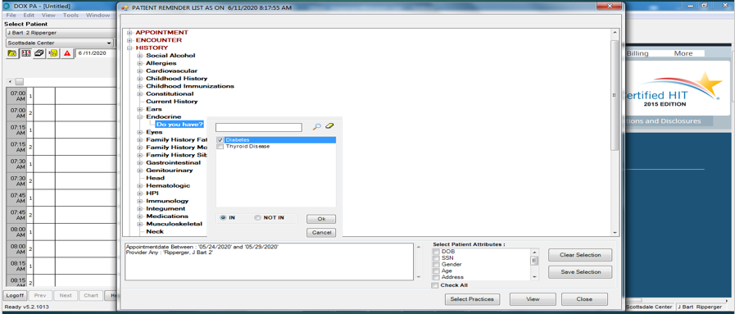
DCT, RWE, HEOR, VEO and all teams can select the specific/critical data points they desire for their particular trials or studies, to achieve optimal analytics.
All past medical history, co-morbidities, prior medications, allergies and more can be selected from over 125 data points Starwriter provides.
Control of data by pharma teams, that will be entered by healthcare providers, guarantees collection of critical data points that optimize accurate and detailed analytics by pharma teams.

Slide 5
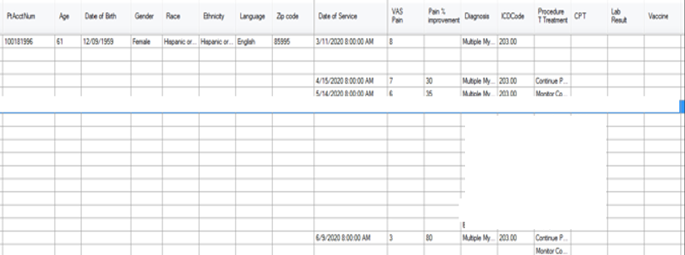
Speed – Real-time streaming of data
As previously described, Starwriter’s patented process enters data directly in the data base, as the healthcare providers are creating their chart notes in the EMR system.
With this, it adheres to the old saying,” quality in – quality out”.
Once details are in the data base, the desired, de-identified data fields are then streamed in real-time to pharma and medical device analytics teams.
This gives real-time access to over 125 critical data points ( only a small sample seen below ) to analytics teams at pharma on all details associated with physician-patient encounters for DCTs, RWE, HEOR, VEO, PRO and all other data needs. All de-identified data, of course.

Slide 6
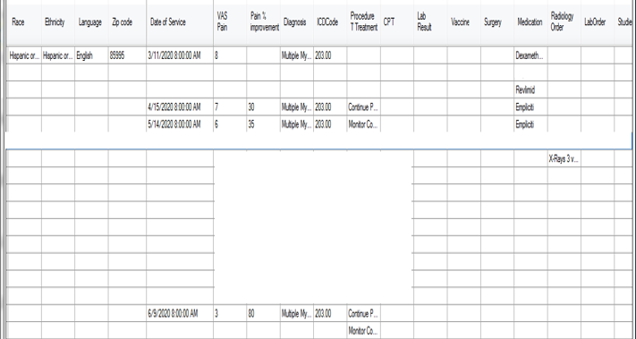
Improvement over time using your company’s products - captured as structured data fields
Healthcare providers enter the amount of improvement, which is captured as numeric data fields from 2 perspectives:
A. percentage improvement from the prior visit- entered by the healthcare provider- objective data
B. VAS pain scale rating is entered by the patient - subjective data
Our ability to capture the improvement from one visit to the next as a numeric, in these 2 data fields, lends to more reliable and detailed statistical analytics.
This is in strong opposition to scraping this information from other EMR systems with unstructured data.
In other EMR systems, typically, analytics teams are lucky if the healthcare provider mentioned improvement, any grading of the improvement is even more rare.

Slide 7
In a recent study from Oracle Healthcare, pharma analytics teams listed accuracy, quality and certainty of data, along with delays in receiving data as greatest concerns.
Starwriter’s patented process provides the solution to these concerns, issues and pain points.
Currently, your company/ teams are probably obtaining clinical/ medical data from one of the larger sources. But, their data is typically unstructured, lacks accuracy/detail and is creating unnecessary time delays, all of which are negatively affecting your team’s analytics.
Quality, accuracy and speed which Starwriter data provides is always preferable to larger quantities of data with questionable accuracy, quality and time delays from other data sources, as we demonstrate In the videos on our website.
We have only been able to give a high level view and skimmed the surface of our offering. Since seeing is believing, we recommend scheduling a live demo, to see how we can assist
your company/teams.
If your teams are not able to stream data in real time today and if your teams are not controlling data details, particularly patient improvement using your company’s products – please contact us today- we are eager to reveal the “Next Generation” data source:
Starwriter Medical Data
Dr Bart Ripperger
C: 602 628-2880
E: bart@drbartssolutions.com

